Slide 1
System Design
Day 1

Slide 2
Day-1 Agenda
What is System?
What is Design?
What is System Design?
System Requirement.
Functional Requirement.
Non-Functional requirement.
System design components and its types.
Logical Entities & Tangible Entities.

Slide 3
What is System?
System is a collection of technologies/softwares which communicate with each other in order to serve a set of users to fulfil a set of requirements.
Collection of Technologies or Softwares
Set of Users
Set of Requirements

Slide 4





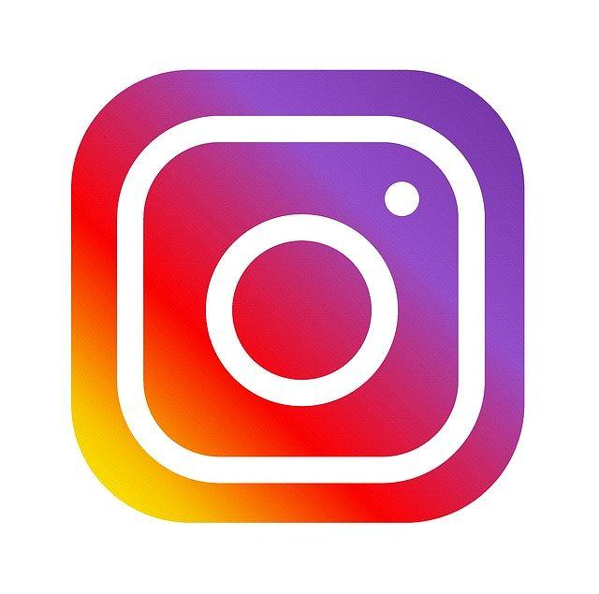

Examples
Digital World
Real World
Whatsapp
Netflix
Instagram
Google Maps
Uber
Hospitals
Banks
Hotels
Theaters

Slide 5
Let’s break it [Whatsapp]
Set of Users
Individuals/Everyday users
Businesses & Professionals
Families
Educational Institutes
Non Profit organizations
Community and Interest Groups
etc
Set of Problem solved
Instant communication
Cost effective messaging
International communication
Voice & Video calls
Multimedia sharing
Group chats
etc

Slide 6
Let’s break it [Netflix]
Set of Users
Individuals/Everyday users
Couples and Friends
Educational Institutes
Film and TV Enthusiasts
Travelers
Language learners
etc
Set of Problem solved
Content visibility
Traditional TV limitations
Cost Effective entertainment
Offline Entertainment
Geographical Restrictions
etc

Slide 7
Let’s break it [Instagram]
Set of Users
Individuals/Everyday users
Brand & Businesses
Celebrities
Creators
Photography Enthusiasts
Food and Lifestyle Enthusiasts
Community and Interest Groups
etc
Set of Problem solved
Visual Storytelling
Global Connections
Creative Expressions
Marketing
Communications & Engagements
etc

Slide 8
Let’s break it [Uber]
Set of Users
?
Set of Problem solved
?

Slide 9
Let’s break it [Banks]
Set of Users
Individuals
Businesses & SMEs
Government and Public Entities
Educational Institutes
Non Profit organizations
etc
Set of Problem solved
Safekeeping and security of funds
Wealth Management
Payment processing and Merchant services
etc

Slide 10
Let’s break it [Hotels]
Set of Users
?
Set of Problem solved
?

Slide 11
What is Design?
Design is a process of understanding the user requirements & selecting the components modules and software technologies and how they are going to intertwined and communicate with each other in order to serve the need of the system that is the basic definition of design.
The whole process of selecting those components, understanding the needs of the users and the requirements and also factoring the different constraints and concerns that whole process entails design.

Slide 12
What is System Design?
In order to understand and develop this skill of designing certain kind of systems which serve to large scale & large users, here system design comes into picture.
Basic Components:
Servers
Databases
Caches
Application
Message Queues

Slide 13
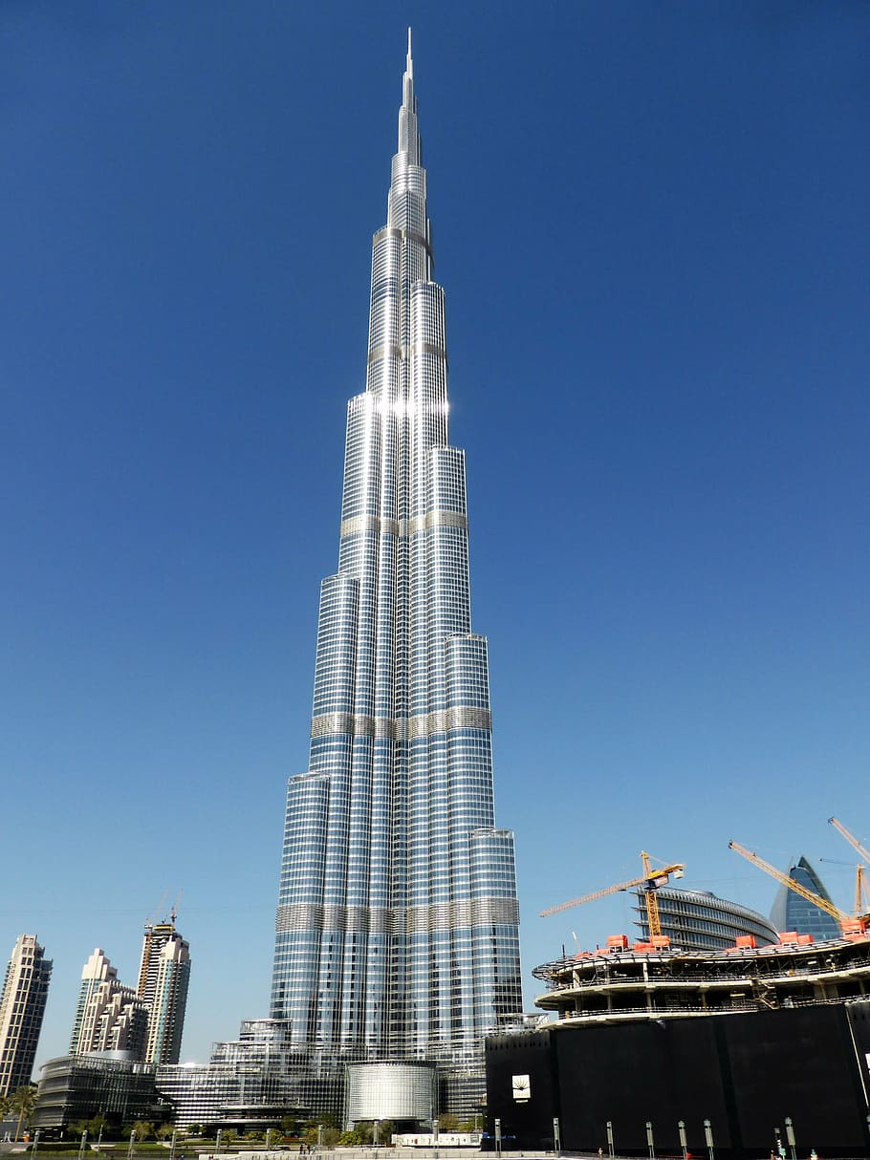
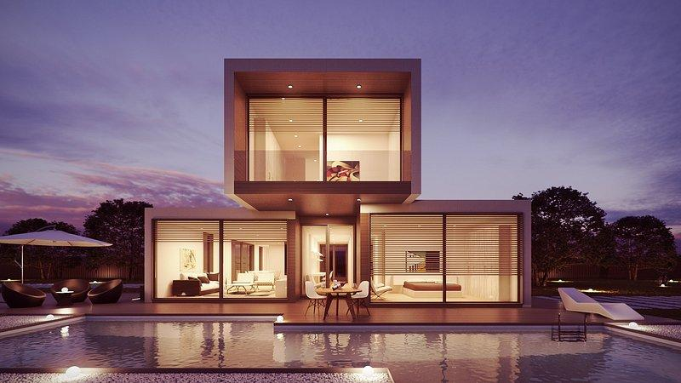
System Designs
Whatsapp
https://ik.imagekit.io/cns0ocqrfxe/whatsapp_system_design_Q6vjlDXG7.webp?updatedAt=1697120133482
Netflix
https://ik.imagekit.io/cns0ocqrfxe/netflix_sytem_design_x1iefUYAR.png?updatedAt=1697120132866
Duplex
Skycrapper

Slide 14
Thank You

